Slide 1
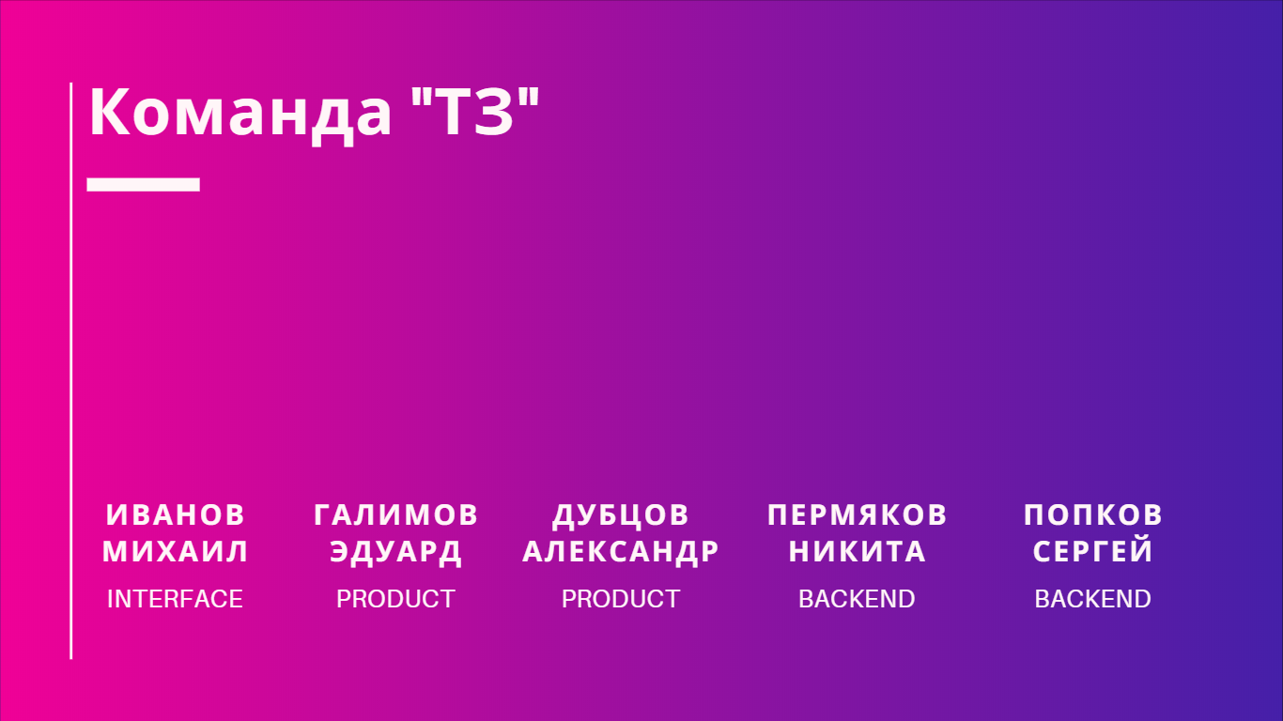




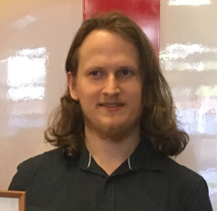

Slide 2
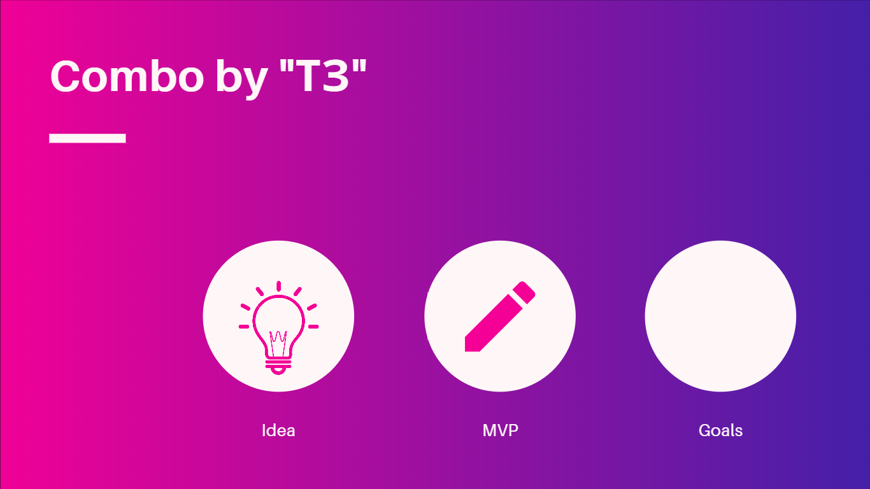


Slide 3




Slide 4




Slide 5

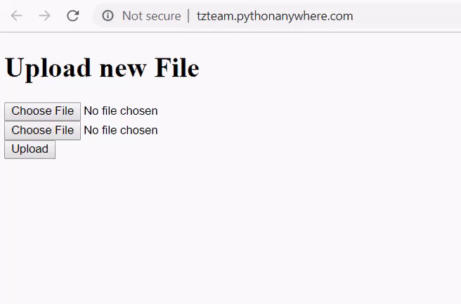
https://github.com/tzteam-photohack/TZ

Slide 6


Slide 7


